Slide 1
Racket Zoo
Date: 10 Apr 24
C311-IUSB
Authors:
Patrick Ryan
Kayla Kerckhove
Katelynn Salisbury
Eleodora Piedra

Slide 2
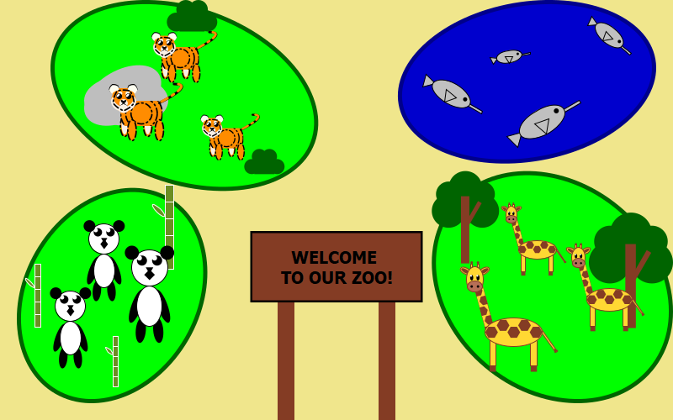

Slide 3
How We Organized It
Imported 2htdp/images
1 driver file (The Zoo)
5 sub-files (The animals and zoo-decals)
Member Participation:
Kayla - Zoo, Extra-decor, Giraffe
Ryan - Swordfish
Katelynn - Lion
Eleodora - Panda
Presentation - Kayla and Ryan

Slide 4
Zoo and Extra-Decor
Used ellipses and overlay/align to plot the enclosures accordingly
For the zoo, used overlay/align to print the animals directly on top of their enclosures
Used let* for all of the decals (trees, bushes, bamboo)
Used several shapes to define all the decals (circles, rectangles, segments, ellipses)
Used overlays/underlays to merge everything as needed (leaves to trees, leaves to bushes, ellipses for rocks, etc)

Slide 5
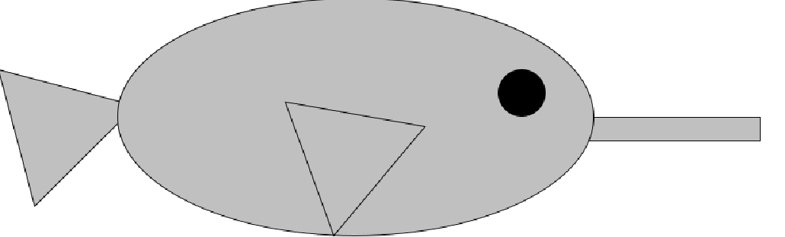
Swordfish
Used let* to define all of the components used to build the picture
Body: used a solid silver ellipse
Fin: used a solid silver triangle
Eye: used a solid black circle
Sword: used a solid silver rectangle
Merging the fin to the body: used overlay/xy
Merging the nose to the body: used overlay/xy
Merging the eye to the body: used underlay/xy

Slide 6
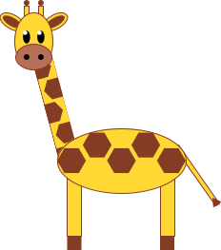
Giraffe
Main Techniques:
Separate functions for each element
Overlay/align/offset
Rotate
Neck:
Imported (require lang/posn)
For loop for create list of 6 spots
For loop to create list of 6 positions
Using make-posn
Used function place-images to place spots on neck
Body:
Manually placed spots using overlay/align/offset
Legs:
Used above function to place hooves on legs
Face:
Placed eyes on head
Placed nose on head
Added Ears and antennas

Slide 7
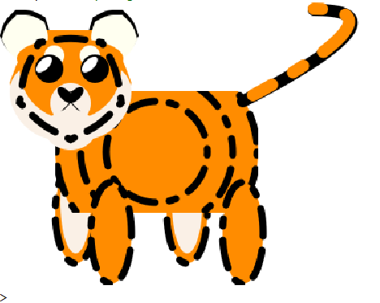
Tiger
Used varying functions from 2htdp/image
overlay/underlay/place-image/scale/make-pen
Used several functions to draw components of the tiger
Tail
Inner Legs and Outer Legs
Eyes and Eyebrows
Face Stripes
Ears
Chin
Used Scale function to adjust size of tiger for zoo project
Used overlay/xy and underlay/xy to position each part of the tiger

Slide 8

Panda
Used let* to compose all the elements
Overlay/offset for eyes, ears, and body-overall
Beside/align to position arms so they connect to the body
Underlay/align/offset to position each leg underneath the body and each arm behind the body
Underlay/offset to position the legs behind the body
Above to connect the head, face, body, and overall together to create panda
Rotate for arms and legs to connect them to the body

Slide 9
Challenges
Understanding images.rkt
Utilizing new functions, understanding new syntax with each new function
Making animals easily sizeable (Dependent on n)
Needed to allow animals’ size to be adjustable due to independent work
Learning how to import and use separate Racket files
Creativity with animal designs
Conflicting schedules
Outside distractions in regard to other classes
Lots of trial and error
Making the animals visually appealing

Slide 10
What We Learned
How to use images.rkt
How to import libraries into Racket projects
Aligning and offsetting images using overlay and underlay
How to connect several different Racket files without copy and pasting code
Calling functions that were defined outside of the project (fish, giraffe, etc)
key words: provide and require
How to organize large Racket projects
Several files being called by one driver file
How to use github repositories

